Slide 1

Reddit Data Scraping & Sentiment Analysis: A Complete Guide with Python

Slide 2
Agenda
Creating a developer Account.
Creating Application.
Essential Libraries
Scrapping data using your new credentials.
Sentiment Analysis.
Word Frequency Analysis.
Word Cloud Visualization.

Slide 3
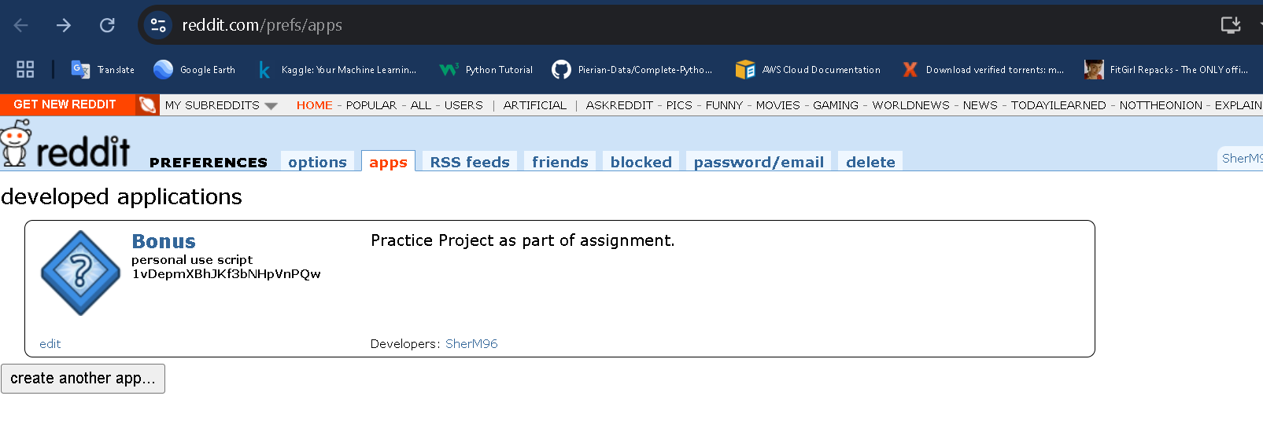
Creating a developer Account

Slide 4
Creating Application

Slide 5
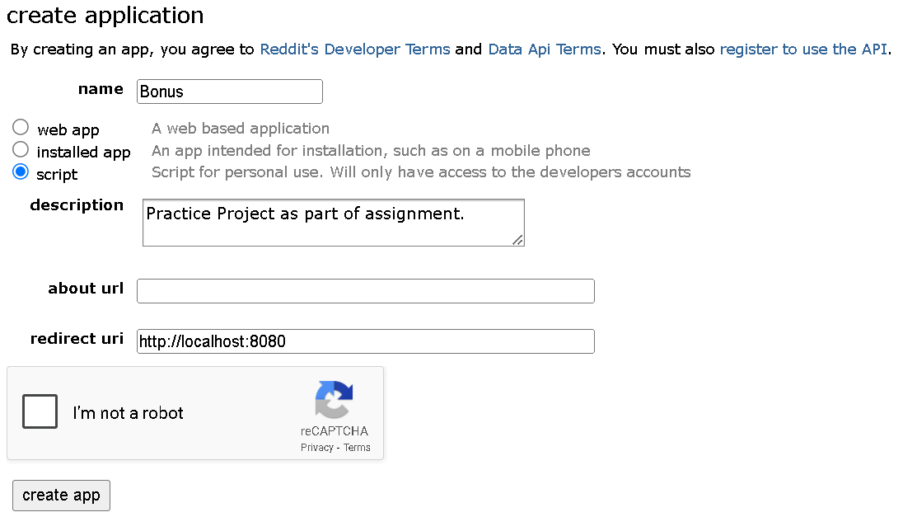
Creating Application

Slide 6
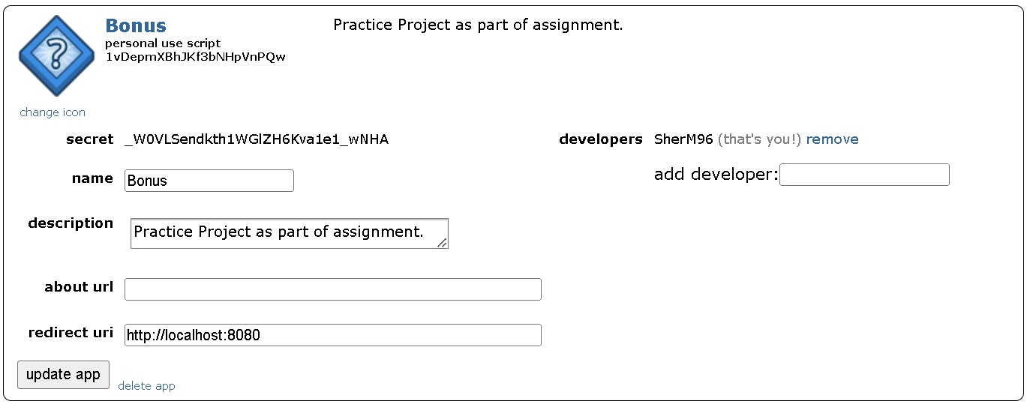
Creating Application

Slide 7
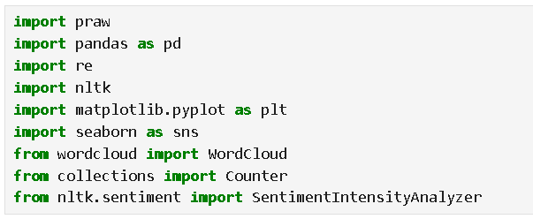
Essential Libraries

Slide 8
Essential Libraries
praw – Python Reddit API Wrapper, used for accessing Reddit data programmatically.
pandas – Data analysis library for handling structured data using DataFrames.
re – Built-in Python module for handling regular expressions and text cleaning.
nltk – Natural Language Toolkit for processing and analyzing human language data.
matplotlib – Visualization library for creating static, animated, and interactive plots.
seaborn – High-level statistical data visualization library built on top of Matplotlib.
WordCloud – Generates word clouds from text data for visualization.collections.
Counter – A Python dictionary subclass for counting hashable objects (e.g., word frequency).
nltk.sentiment.SentimentIntensityAnalyzer – A sentiment analysis tool using VADER (Valence Aware Dictionary and sEntiment Reasoner).

Slide 9
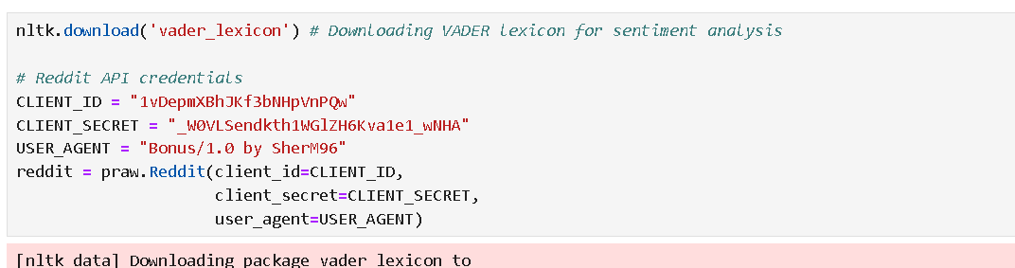
Scrapping Data using your new credentials

Slide 10
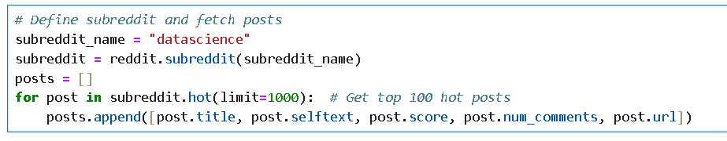
Scrapping Data using your new credentials
Define subreddit and fetch posts

Slide 11
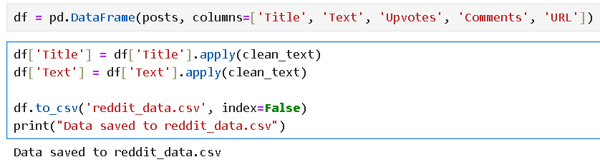
Sentiment Analysis

Slide 12
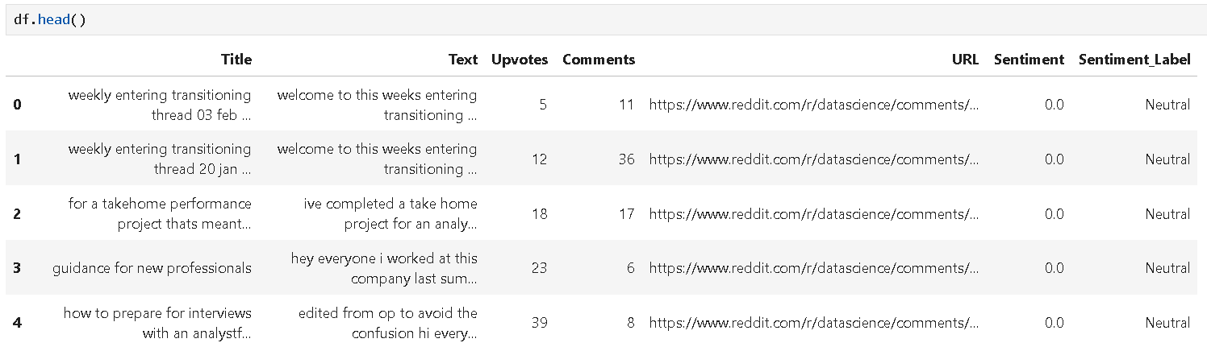
Sentiment Analysis
Tabular view of first few eows of extracted data:

Slide 13
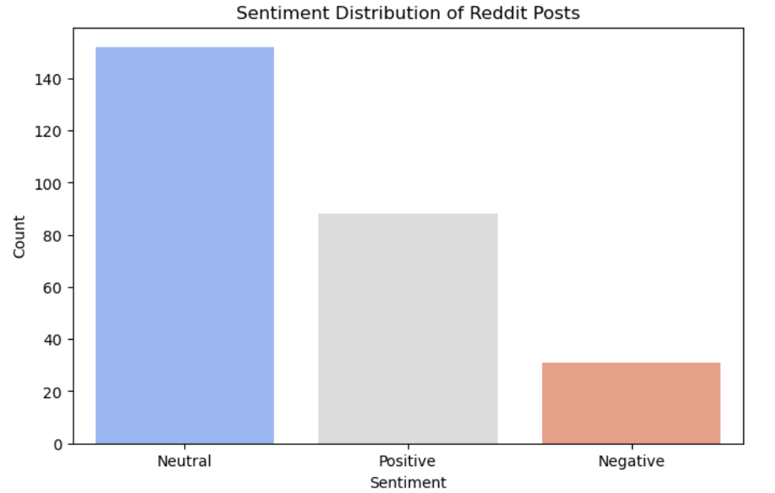
Sentiment Analysis
Generic sentiment of subreddits regarding data science within top 1000 posts:

Slide 14
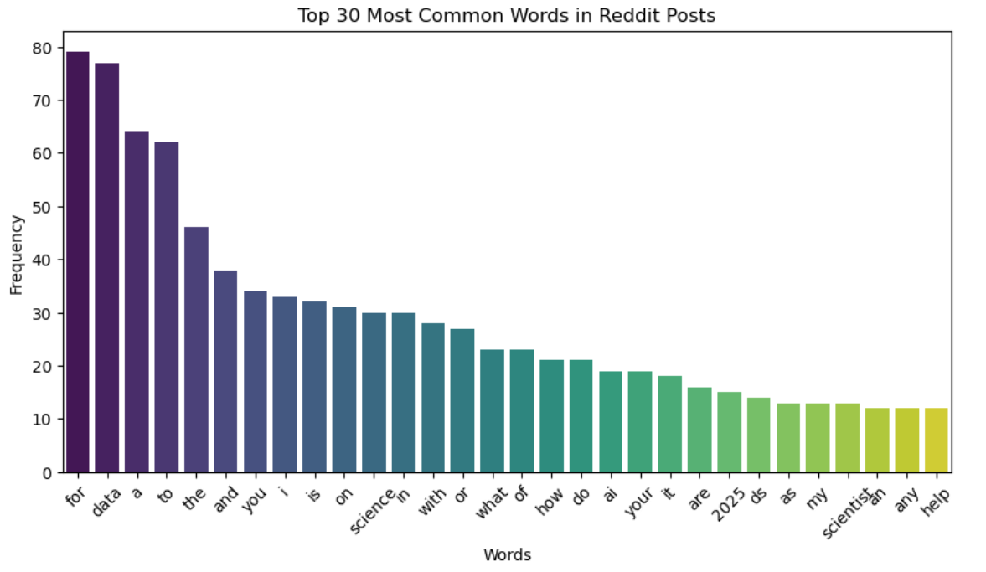
Word Frequency Analysis
Top 30 words used in top 1000 subreddits for Data Science:

Slide 15
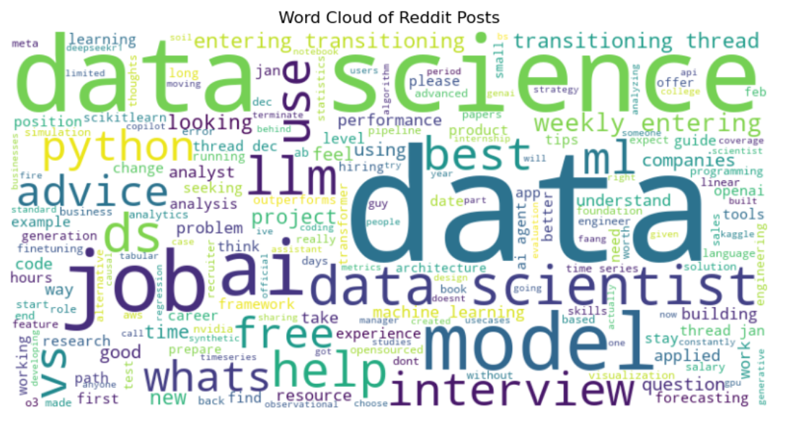
Word Cloud

Slide 16
Questions

